Slide 1
Deep Learning: An Overview
Weifeng Li, Victor Benjamin, Xiao Liu, and Hsinchun Chen
University of Arizona

Slide 2
Acknowledgements
Many of the pictures, results, and other materials are taken from:
Aarti Singh, Carnegie Mellon University
Andrew Ng, Stanford University
Barnabas Poczos, Carnegie Mellon University
Christopher Manning, Stanford University
Geoffrey Hinton, Google & University of Toronto
Richard Socher, MetaMind
Richard Turner, University of Cambridge
Yann LeCun, New York University
Yoshua Bengio, Universite de Montreal

Slide 3
Outline
Introduction
Motivation
Deep Learning Intuition
Neural Network
Neuron, Feedforward algorithm, and Backpropagation algorithm
Limitations
Deep Learning
Deep Belief Network: Autoencoder & Restricted Boltzman Machine
Convolutional Neural Network
Deep Learning for Text Mining
Word Embedding
Recurrent Neural Network
Recursive Neural Network
Conclusions

Slide 4
Outline
Introduction
Motivation
Deep Learning Intuition
Neural Network
Neuron, Feedforward algorithm, and Backpropagation algorithm
Limitations
Deep Learning
Deep Belief Network: Autoencoder & Restricted Boltzman Machine
Convolutional Neural Network
Deep Learning for Text Mining
Word Embedding
Recurrent Neural Network
Recursive Neural Network
Conclusions

Slide 5
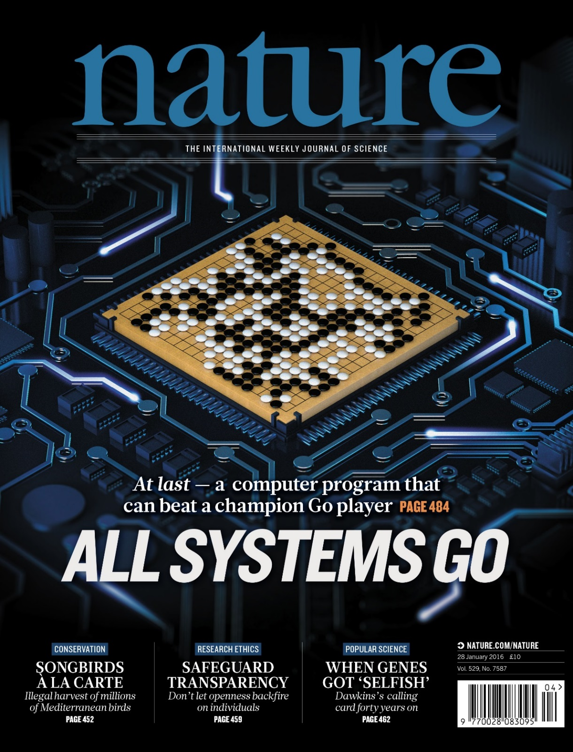
In “Nature” 27 January 2016:
“DeepMind’s program AlphaGo beat Fan Hui, the European Go champion, five times out of five in tournament conditions...”
“AlphaGo was not preprogrammed to play Go: rather, it learned using a general-purpose algorithm that allowed it to interpret the game’s patterns.”
“…AlphaGo program applied deep learning in neural networks (convolutional NN) — brain-inspired programs in which connections between layers of simulated neurons are strengthened through examples and experience.”

Slide 6
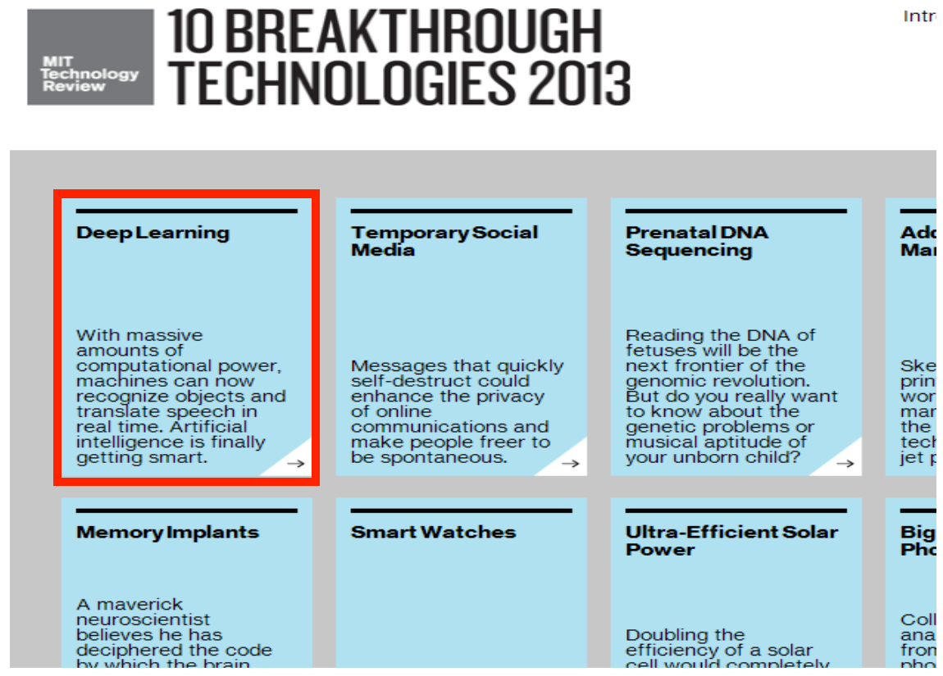

Slide 7
Deep Learning Today
Advancement in speech recognition in the last 2 years
A few long-standing performance records were broken with deep learning methods
Microsoft and Google have both deployed DL-based speech recognition systems in their products
Advancement in Computer Vision
Feature engineering is the bread-and-butter of a large portion of the CV community, which creates some resistance to feature learning
But the record holders on ImageNet and Semantic Segmentation are convolutional nets
Advancement in Natural Language Processing
Fine-grained sentiment analysis, syntactic parsing
Language model, machine translation, question answering

Slide 8
Motivations for Deep Architectures
Insufficient depth can hurt
With shallow architecture (SVM, NB, KNN, etc.), the required number of nodes in the graph (i.e. computations, and also number of parameters, when we try to learn the function) may grow very large.
Many functions that can be represented efficiently with a deep architecture cannot be represented efficiently with a shallow one.
The brain has a deep architecture
The visual cortex shows a sequence of areas each of which contains a representation of the input, and signals flow from one to the next.
Note that representations in the brain are in between dense distributed and purely local: they are sparse: about 1% of neurons are active simultaneously in the brain.
Cognitive processes seem deep
Humans organize their ideas and concepts hierarchically.
Humans first learn simpler concepts and then compose them to represent more abstract ones.
Engineers break-up solutions into multiple levels of abstraction and processing
Notes:
Simplify it.

Slide 9
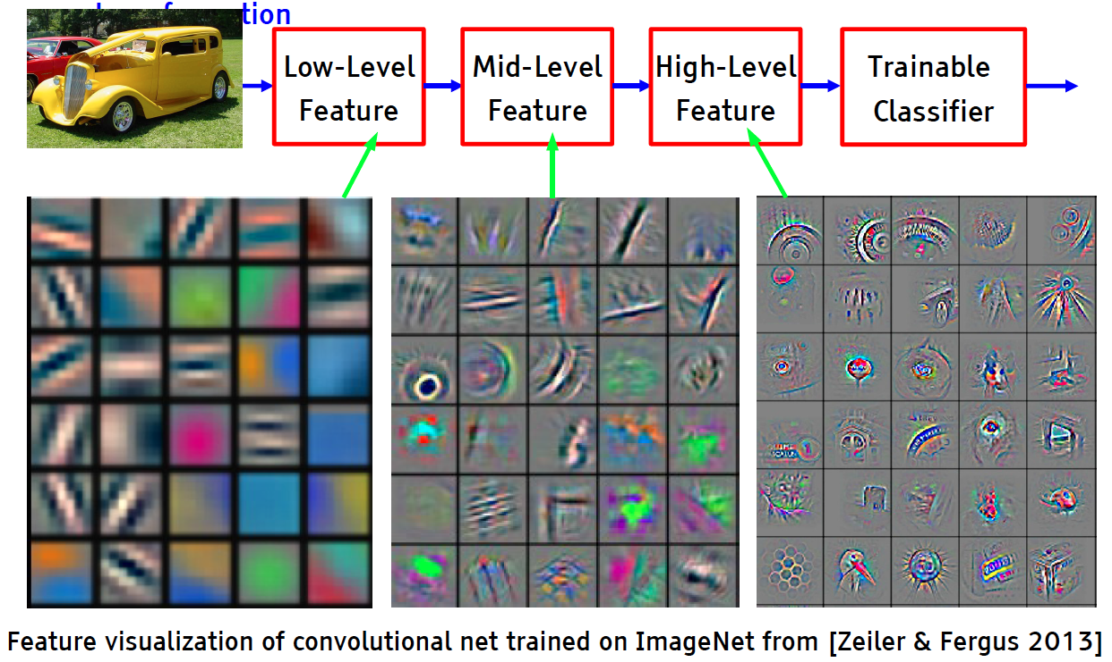
Deep Learning = Learning Hierarchical Representations

Slide 10
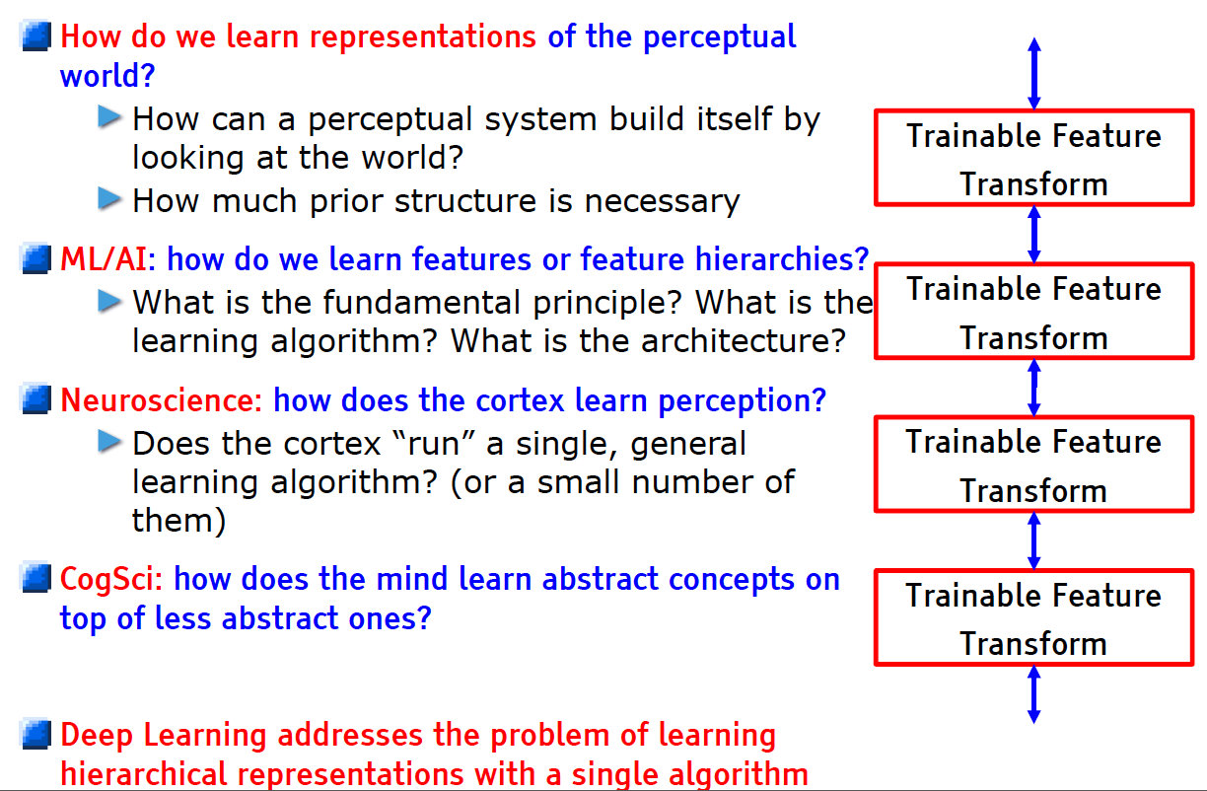
Learning Representations: a challenge for ML, CV, AI, Neuroscience, Cognitive Science...

Slide 11
Outline
Introduction
Motivation
Deep Learning Intuition
Neural Network
Neuron, Feedforward algorithm, and Backpropagation algorithm
Limitations
Deep Learning
Deep Belief Network: Autoencoder & Restricted Boltzman Machine
Convolutional Neural Network
Deep Learning for Text Mining
Word Embedding
Recurrent Neural Network
Recursive Neural Network
Conclusions

Slide 12
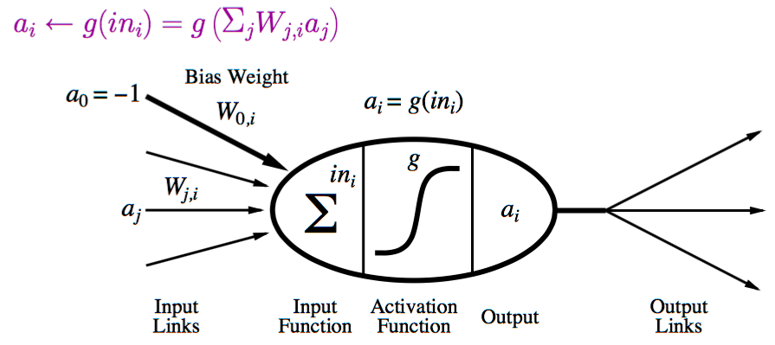
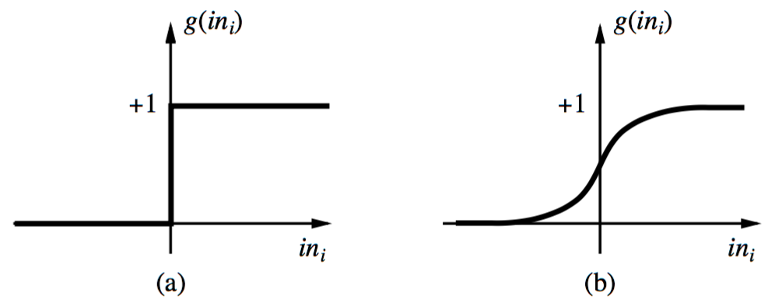
Neural Network: A Neuron
A neuron is a computational unit in the neural network that exchanges messages with each other.
Possible activation functions:
Step function/threshold function
Sigmoid function (a.k.a, logistic function)

Slide 13
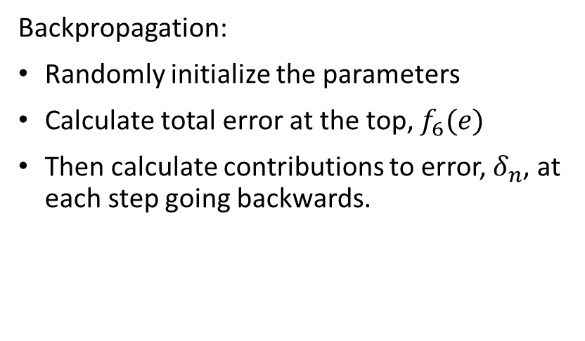
Feed forward/Backpropagation Neural Network
Feed forward algorithm:
Activate the neurons from the bottom to the top.
Backpropagation:
Randomly initialize the parameters
Calculate total error at the top, $f_{6}(e)$
Then calculate contributions to error, $δ_{n}$, at each step going backwards.

Slide 14
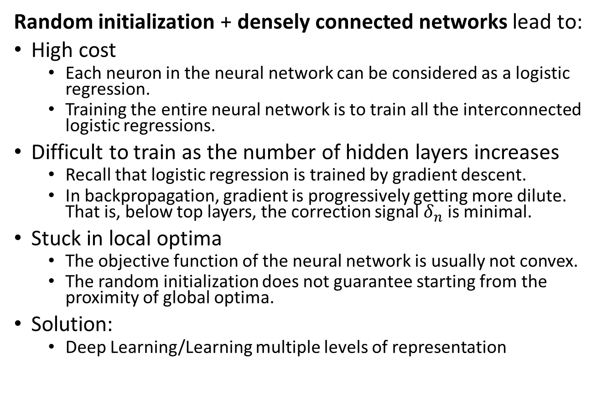
Limitations of Neural Networks
Random initialization + densely connected networks lead to:
High cost
Each neuron in the neural network can be considered as a logistic regression.
Training the entire neural network is to train all the interconnected logistic regressions.
Difficult to train as the number of hidden layers increases
Recall that logistic regression is trained by gradient descent.
In backpropagation, gradient is progressively getting more dilute. That is, below top layers, the correction signal $δ_{n}$ is minimal.
Stuck in local optima
The objective function of the neural network is usually not convex.
The random initialization does not guarantee starting from the proximity of global optima.
Solution:
Deep Learning/Learning multiple levels of representation

Slide 15
Outline
Introduction
Motivation
Deep Learning Intuition
Neural Network
Neuron, Feedforward algorithm, and Backpropagation algorithm
Limitations
Deep Learning
Deep Belief Network: Autoencoder & Restricted Boltzman Machine
Convolutional Neural Network
Deep Learning for Text Mining
Word Embedding
Recurrent Neural Network
Recursive Neural Network
Conclusions

Slide 16
Deep Learning
We will cover two major deep learning models:
Deep Belief Networks and Autoencoders employs layer-wise unsupervised learning to initialize each layer and capture multiple levels of representation simultaneously.
Hinton, G. E, Osindero, S., and Teh, Y. W. (2006). A fast learning algorithm for deep belief nets. Neural Computation, 18:1527-1554.
Bengio, Y., Lamblin, P., Popovici, P., Larochelle, H. (2007). Greedy Layer-Wise Training of Deep Networks, Advances in Neural Information Processing Systems 19
Convolutional Neural Network organizes neurons based on animal’s visual cortex system, which allows for learning patterns at both local level and global level.
Y. LeCun, L. Bottou, Y. Bengio and P. Haffner: Gradient-Based Learning Applied to Document Recognition, Proceedings of the IEEE, 86(11):2278-2324, November 1998

Slide 17
Deep Belief Networks
A deep belief network (DBN) is a probabilistic, generative model made up of multiple layers of hidden units.
A composition of simple learning modules that make up each layer
A DBN can be used to generatively pre-train a DNN by using the learned DBN weights as the initial DNN weights.
Back-propagation or other discriminative algorithms can then be applied for fine-tuning of these weights.
Advantages:
Particularly helpful when limited training data are available
These pre-trained weights are closer to the optimal weights than are randomly chosen initial weights.

Slide 18
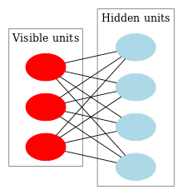
Restricted Boltzmann Machine
A DBN can be efficiently trained in an unsupervised, layer-by-layer manner, where the layers are typically made of restricted Boltzmann machines (RBM).
RBM: undirected, generative energy-based model with a "visible" input layer and a hidden layer, and connections between the layers but not within layers.
The training method for RBMs proposed by Geoffrey Hinton for use with training "Product of Expert" models is called contrastive divergence (CD).
An RBM with fully connected visible and hidden units. Note there are no hidden-hidden or visible-visible connections.

Slide 19
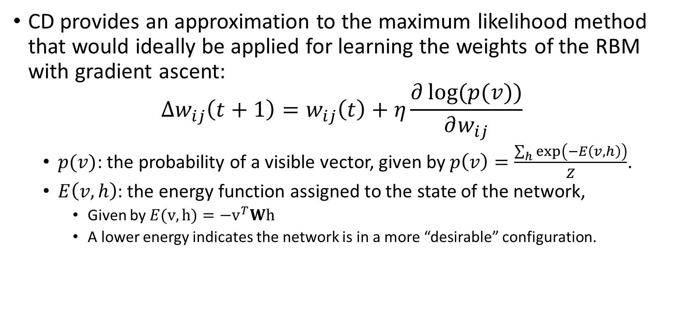
Contrastive Divergence (CD)
CD provides an approximation to the maximum likelihood method that would ideally be applied for learning the weights of the RBM with gradient ascent: $∆w_{ij}\left(t+1\right)=w_{ij}\left(t\right)+η\frac{∂\log{(p(v))}}{∂w_{ij}}$
$p(v)$: the probability of a visible vector, given by $p\left(v\right)=\frac{\sum_{h}{\exp\left(−E\left(v,h\right)\right)}}{Z}$.
$E\left(v,h\right)$: the energy function assigned to the state of the network,
Given by $E(v,h)=−v^{T}Wh$
A lower energy indicates the network is in a more “desirable” configuration.

Slide 20
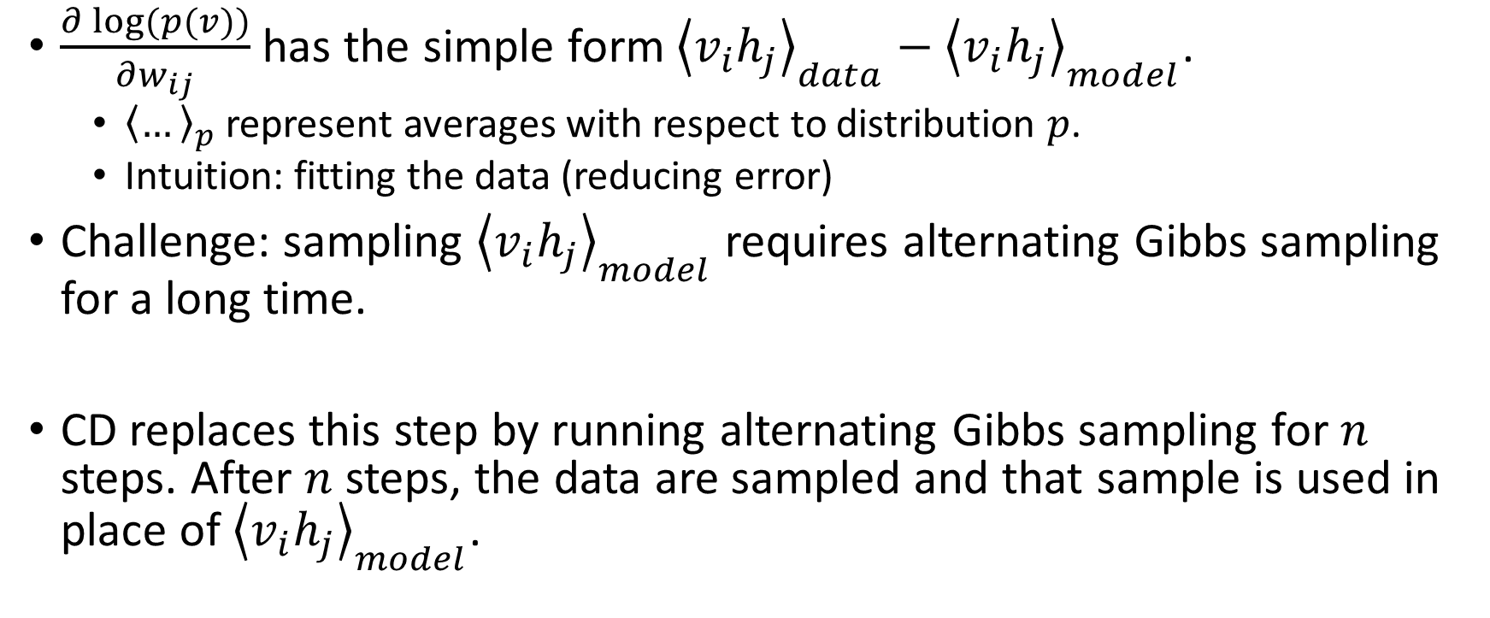
Contrastive Divergence (CD)
$\frac{∂\log{(p(v))}}{∂w_{ij}}$ has the simple form ${\left\langle v_{i}h_{j}\right\rangle }_{data}−{\left\langle v_{i}h_{j}\right\rangle }_{model}$.
${\left\langle …\right\rangle }_{p}$ represent averages with respect to distribution $p$.
Intuition: fitting the data (reducing error)
Challenge: sampling ${\left\langle v_{i}h_{j}\right\rangle }_{model}$ requires alternating Gibbs sampling for a long time.
CD replaces this step by running alternating Gibbs sampling for $n$ steps. After $n$ steps, the data are sampled and that sample is used in place of ${\left\langle v_{i}h_{j}\right\rangle }_{model}$.

Slide 21
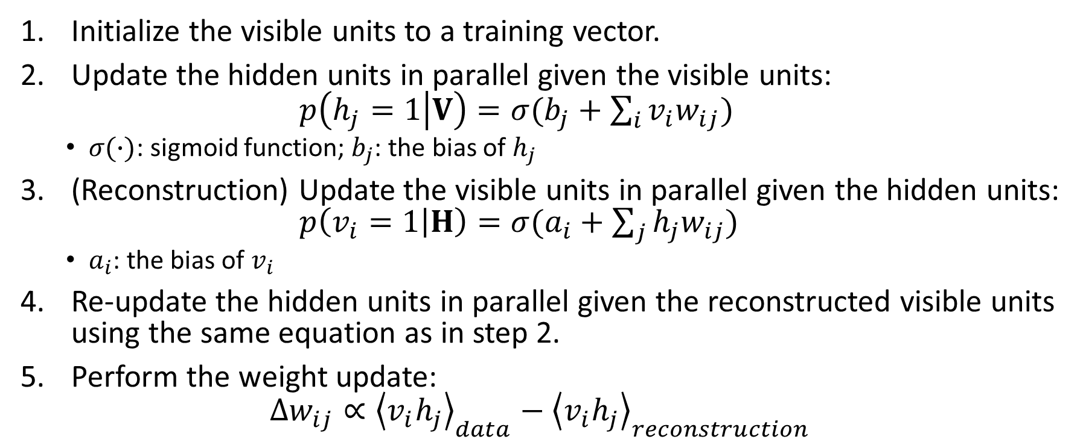
The CD procedure
Initialize the visible units to a training vector.
Update the hidden units in parallel given the visible units: $p\left(h_{j}=1 | V\right)=σ(b_{j}+\sum_{i}{v_{i}w_{ij}})$
$σ(∙)$: sigmoid function; $b_{j}$: the bias of $h_{j}$
(Reconstruction) Update the visible units in parallel given the hidden units: $p\left(v_{i}=1 | H\right)=σ(a_{i}+\sum_{j}{h_{j}w_{ij}})$
$a_{i}$: the bias of $v_{i}$
Re-update the hidden units in parallel given the reconstructed visible units using the same equation as in step 2.
Perform the weight update: $∆w_{ij}∝{\left\langle v_{i}h_{j}\right\rangle }_{data}−{\left\langle v_{i}h_{j}\right\rangle }_{reconstruction}$

Slide 22
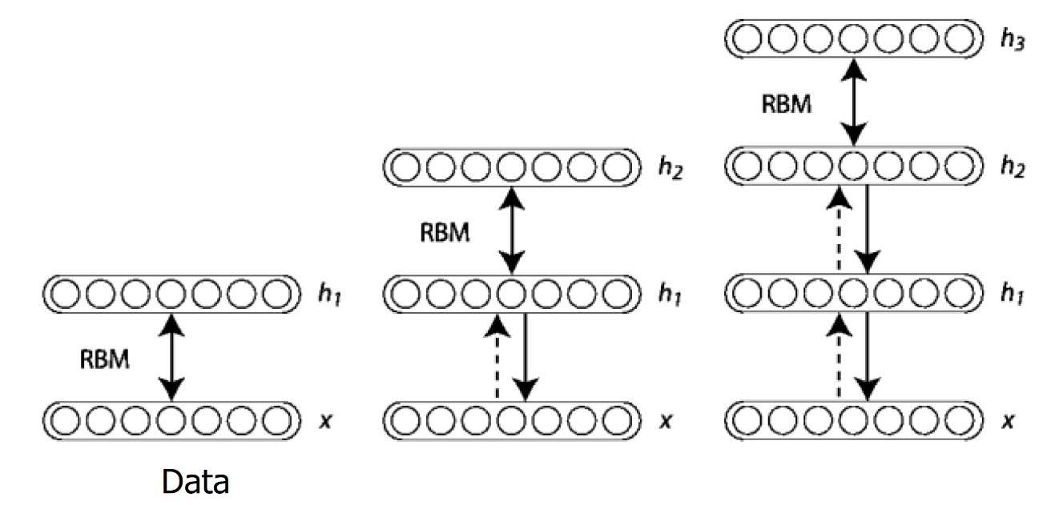
Deep Belief Network Architecture
Once an RBM is trained, another RBM is "stacked" atop it, taking its input from the final already-trained layer.
The new visible layer is initialized to a training vector, and values for the units in the already-trained layers are assigned using the current weights and biases.
The new RBM is then trained with the CD procedure.
This whole process is repeated until some desired stopping criterion is met.

Slide 23
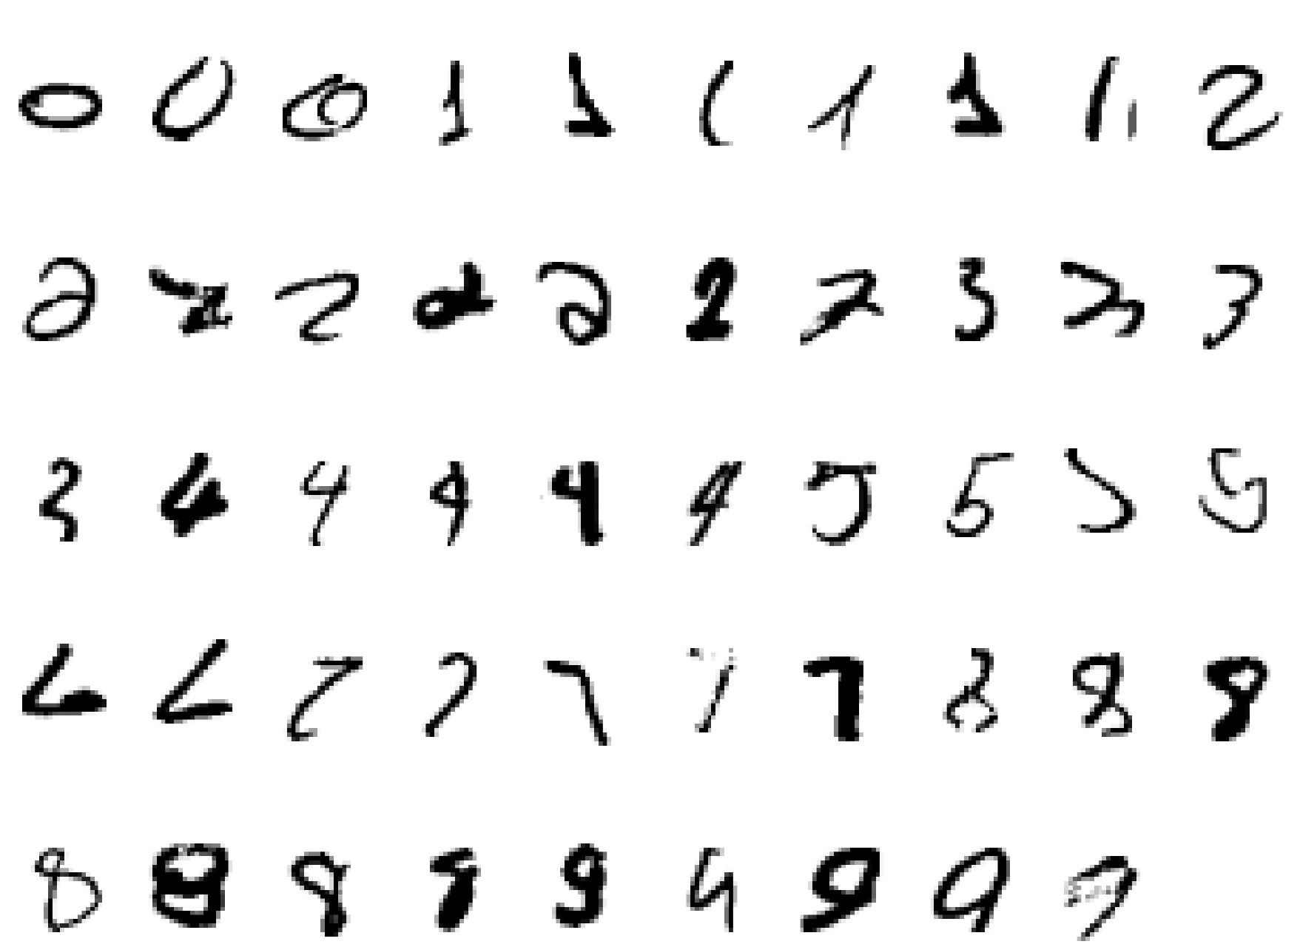
DBN Example: Hand-written Digit Recognition
Input:

Slide 24
DBN Example: Hand-written Digit Recognition
2000 top-level neurons
The top two layers form an associative memory whose energy landscape models the low dimensional manifolds of the digits.
10 label neurons
500 neurons
The model learns to generate combinations of labels and images.
To perform recognition we start with a neutral state of the label units and do an up-pass from the image followed by a few iterations of the top-level associative memory.
500 neurons
28 x 28 pixel image

Slide 25
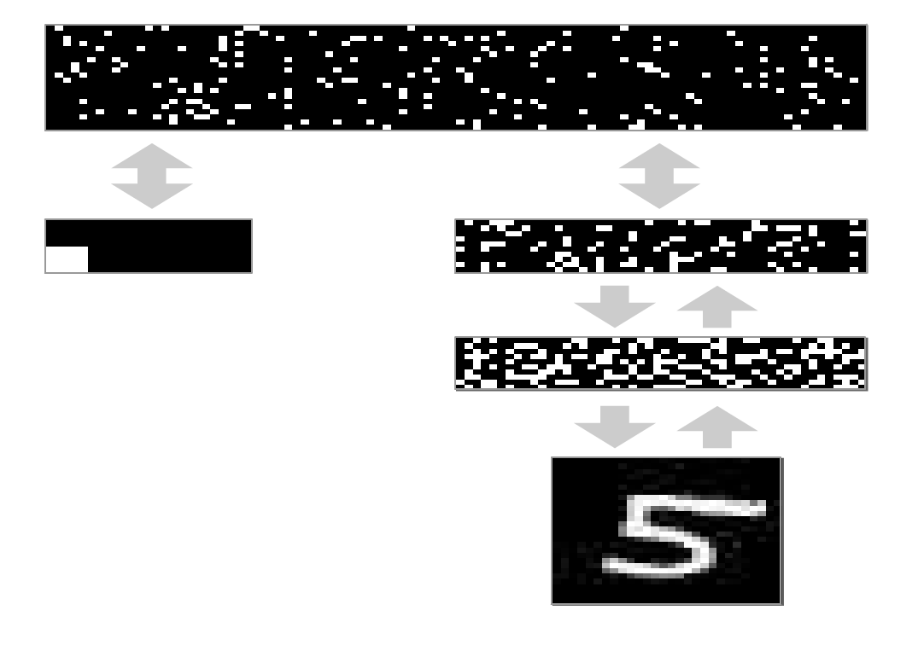
DBN Example: Hand-written Digit Recognition
2000 top-level neurons
500 neurons
10 label neurons
500 neurons
28 x 28 pixel image

Slide 26
DBN Example: Hand-written Digit Recognition
How well does it discriminate on MNIST test set (hand-written image) with no extra information about geometric distortions?
Generative model based on RBM’s 1.25% (error rate)
Support Vector Machine (Decoste et. al.) 1.4%
Backprop with 1000 hiddens (Platt) ~1.6%
Backprop with 500 -->300 hiddens ~1.6%
K-Nearest Neighbor ~ 3.3%
See Le Cun et. al. 1998 for more results
Its better than backprop and much more neurally plausible because the neurons only need to send one kind of signal, and the teacher can be another sensory input.

Slide 27
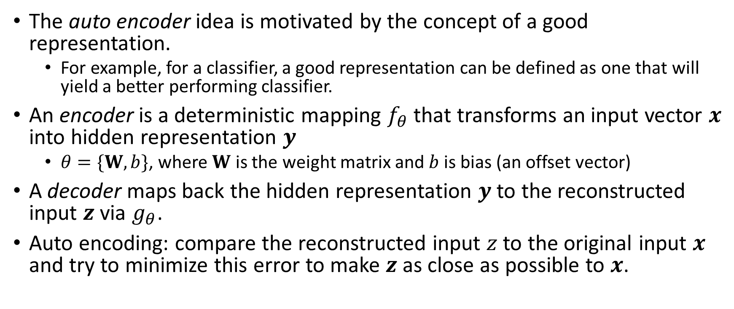
Auto Encoders
The auto encoder idea is motivated by the concept of a good representation.
For example, for a classifier, a good representation can be defined as one that will yield a better performing classifier.
An encoder is a deterministic mapping $f_{θ}$ that transforms an input vector $x$ into hidden representation $y$
$θ=\{W,b\}$, where $W$ is the weight matrix and $b$ is bias (an offset vector)
A decoder maps back the hidden representation $y$ to the reconstructed input $z$ via $g_{θ}$.
Auto encoding: compare the reconstructed input $z$ to the original input $x$ and try to minimize this error to make $z$ as close as possible to $x$.

Slide 28
De-noising Auto Encoders
In Vincent et al. (2010), “a good representation is one that can be obtained robustly from a corrupted input and that will be useful for recovering the corresponding clean input.”
The higher level representations are relatively stable and robust to input corruption.
It is necessary to extract features that are useful for representation of the input distribution.
In de-noising auto encoders, the partially corrupted output is cleaned (de-noised).

Slide 29
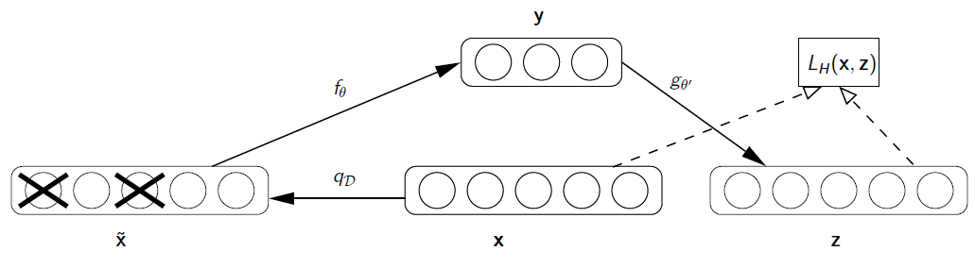
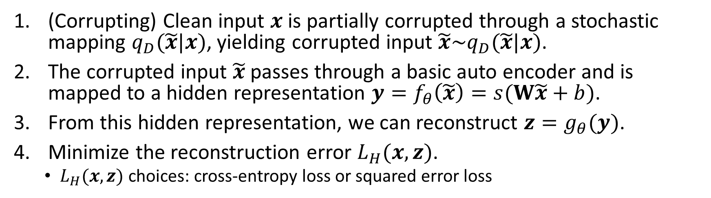
De-noising Auto Encoders Procedure
(Corrupting) Clean input $x$ is partially corrupted through a stochastic mapping $q_{D}(\tilde{x}|x)$, yielding corrupted input $\tilde{x}\sim q_{D}(\tilde{x}|x)$.
The corrupted input $\tilde{x}$ passes through a basic auto encoder and is mapped to a hidden representation $y=f_{θ}\left(\tilde{x}\right)=s(W\tilde{x}+b)$.
From this hidden representation, we can reconstruct $z=g_{θ}(y)$.
Minimize the reconstruction error $L_{H}(x,z)$.
$L_{H}(x,z)$ choices: cross-entropy loss or squared error loss

Slide 30
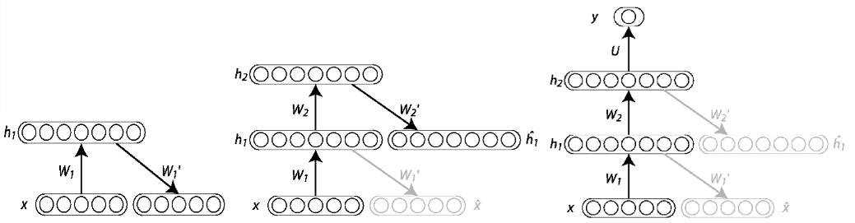
Stacked De-noising Auto Encoder Architecture
In order to make a deep architecture, auto encoders stack one on top of another.
Once the encoding function $f_{θ}$ of the first denoising auto encoder is learned and used to reconstruct the corrupted input, we can train the second level.
Once the stacked auto encoder is trained, its output can be used as the input to a supervised learning algorithm such as support vector machine classifier or a multi-class logistic regression.

Slide 31
Example: Information Retrieval
We can use an auto encoder to find low-dimensional codes for documents that allow fast and accurate retrieval of similar documents from a large set.
We start by converting each document into a “bag of words”. This a 2000 dimensional vector that contains the counts for each of the 2000 commonest words.

Slide 32
Example: Information Retrieval
output vector
2000 reconstructed counts
We train the neural network to reproduce its input vector as its output
This forces it to compress as much information as possible into the 10 numbers in the central bottleneck.
These 10 numbers are then a good way to compare documents.
500 neurons
250 neurons
10
250 neurons
500 neurons
2000 word counts
input vector

Slide 33
Example: Information Retrieval
Train on bags of 2000 words for 400,000 training cases of business documents.
First train a stack of RBM’s. Then fine-tune with backprop.
Test on a separate 400,000 documents.
Pick one test document as a query. Rank order all the other test documents by using the cosine of the angle between codes.
Repeat this using each of the 400,000 test documents as the query (requires 0.16 trillion comparisons).
Plot the number of retrieved documents against the proportion that are in the same hand-labeled class as the query document.

Slide 34
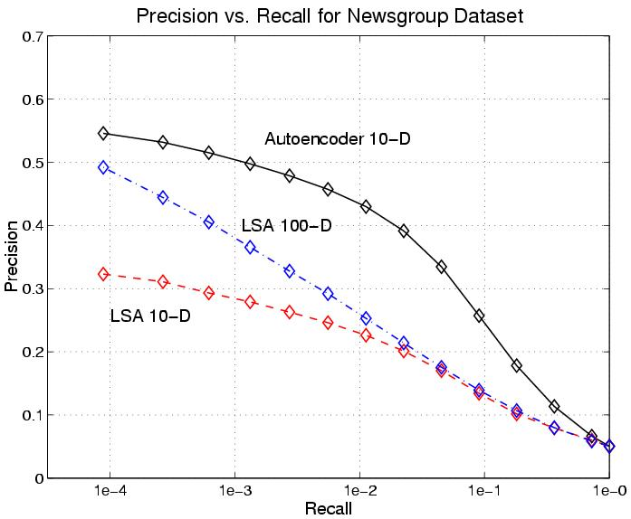
Example: Information Retrieval
The shortlist found using binary codes actually improves the precision-recall curves of TF-IDF.
Locality sensitive hashing (the fastest other method) is 50 times slower and has worse precision-recall curves.
Vs. Latent Semantic Analysis (LSA)

Slide 35
Convolutional Neural Network (CNN)
Convolutional Neural Networks are inspired by mammalian visual cortex.
The visual cortex contains a complex arrangement of cells, which are sensitive to small sub-regions of the visual field, called a receptive field. These cells act as local filters over the input space and are well-suited to exploit the strong spatially local correlation present in natural images.
Two basic cell types:
Simple cells respond maximally to specific edge-like patterns within their receptive field.
Complex cells have larger receptive fields and are locally invariant to the exact position of the pattern.

Slide 36
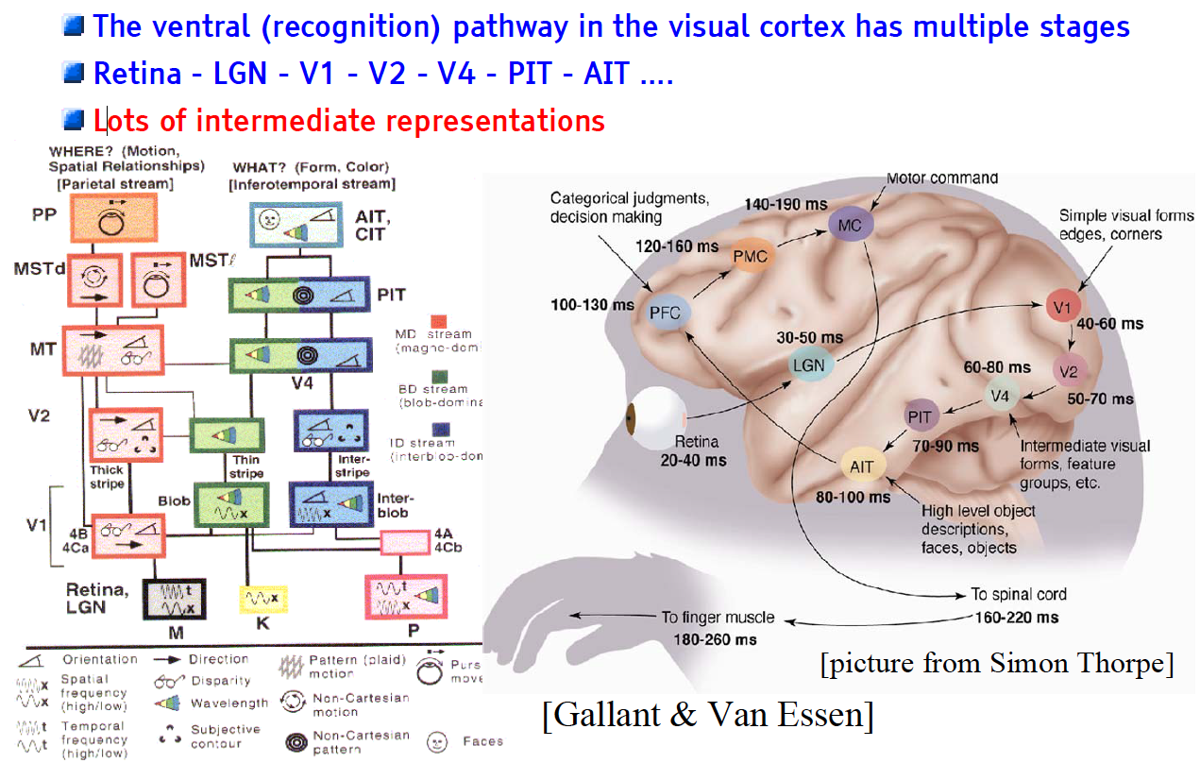
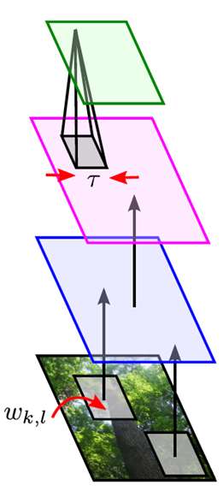
The Mammalian Visual Cortex Inspires CNN
Convolutional Neural Net
output
input

Slide 37
CNN Architecture
Intuition: Neural network with specialized connectivity structure,
Stacking multiple layers of feature extractors
Low-level layers extract local features.
High-level layers extract learn global patterns.
A CNN is a list of layers that transform the input data into an output class/prediction.
There are a few distinct types of layers:
Convolutional layer
Non-linear layer
Pooling layer

Slide 38
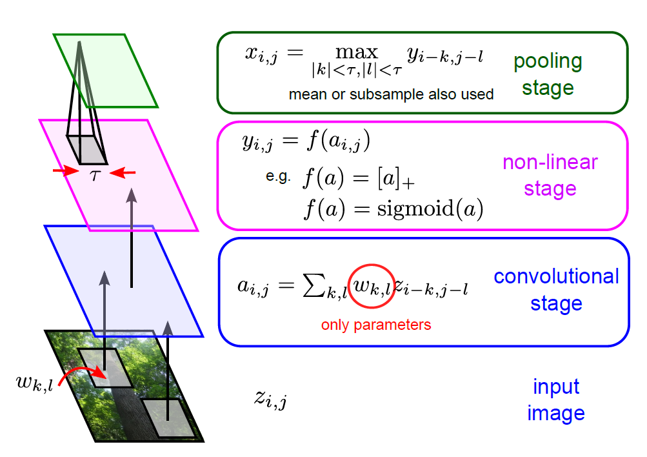
Building-blocks for CNN’s
Feature maps of a larger region are combined.
Feature maps are trained with neurons.
Shared weights
Each sub-region yields a feature map, representing its feature.
Images are segmented into sub-regions.

Slide 39
CNN Architecture: Convolutional Layer
The core layer of CNNs
The convolutional layer consists of a set of filters.
Each filter covers a spatially small portion of the input data.
Each filter is convolved across the dimensions of the input data, producing a multidimensional feature map.
As we convolve the filter, we are computing the dot product between the parameters of the filter and the input.
Intuition: the network will learn filters that activate when they see some specific type of feature at some spatial position in the input.
The key architectural characteristics of the convolutional layer is local connectivity and shared weights.

Slide 40
CNN Convolutional Layer: Local Connectivity
Neurons in layer m are only connected to 3 adjacent neurons in the m-1 layer.
Neurons in layer m+1 have a similar connectivity with the layer below.
Each neuron is unresponsive to variations outside of its receptive field with respect to the input.
Receptive field: small neuron collections which process portions of the input data
The architecture thus ensures that the learnt feature extractors produce the strongest response to a spatially local input pattern.

Slide 41
CNN Convolutional Layer: Shared Weights
We show 3 hidden neurons belonging to the same feature map (the layer right above the input layer).
Weights of the same color are shared—constrained to be identical.
Gradient descent can still be used to learn such shared parameters, with only a small change to the original algorithm.
The gradient of a shared weight is simply the sum of the gradients of the parameters being shared.
Replicating neurons in this way allows for features to be detected regardless of their position in the input.
Additionally, weight sharing increases learning efficiency by greatly reducing the number of free parameters being learnt.

Slide 42
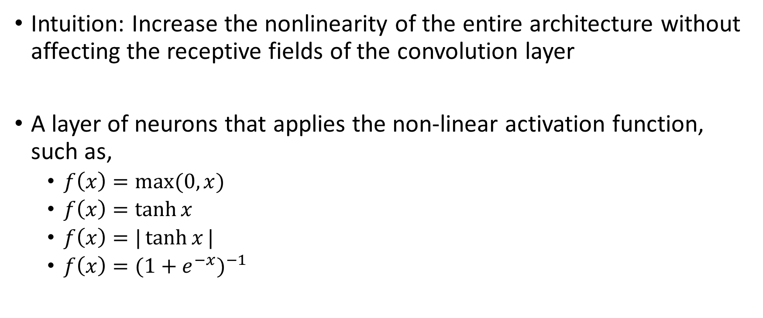
CNN Architecture: Non-linear Layer
Intuition: Increase the nonlinearity of the entire architecture without affecting the receptive fields of the convolution layer
A layer of neurons that applies the non-linear activation function, such as,
$f\left(x\right)=\max{(0,x)}$
$f\left(x\right)=\tanh{x}$
$f\left(x\right)=|\tanh{x}|$
$f\left(x\right)={(1+e^{−x})}^{−1}$

Slide 43


CNN Architecture: Pooling Layer
Intuition: to progressively reduce the spatial size of the representation to reduce the amount of parameters and computation in the network, and hence to also control overfitting
Pooling partitions the input image into a set of non-overlapping rectangles and, for each such sub-region, outputs the maximum value of the features in that region.
Input

Slide 44
Building-blocks for CNN’s
Feature maps of a larger region are combined.
Feature maps are trained with neurons.
Shared weights
Each sub-region yields a feature map, representing its feature.
Images are segmented into sub-regions.

Slide 45
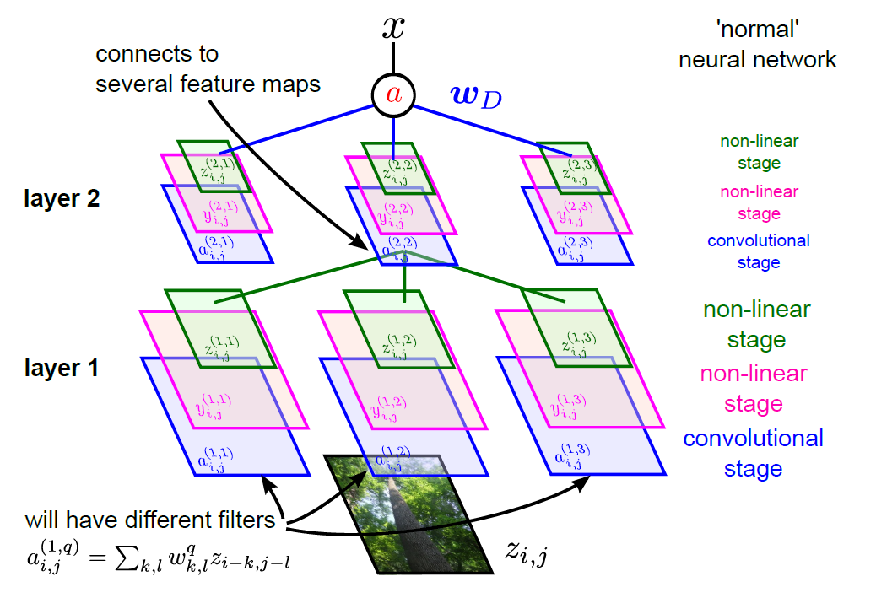
Full CNN
pooling
pooling

Slide 46
Outline
Introduction
Motivation
Deep Learning Intuition
Neural Network
Neuron, Feedforward algorithm, and Backpropagation algorithm
Limitations
Deep Learning
Deep Belief Network: Autoencoder & Restricted Boltzman Machine
Convolutional Neural Network
Deep Learning for Text Mining
Recurrent Neural Network
Recursive Neural Network
Word Embedding
Conclusions

Slide 47
Deep Learning for Text Mining
Building deep learning models on textual data requires:
Representation of the basic text unit, word.
Neural network structure that can hierarchically capture the sequential nature of text.
Deep learning models for text mining use:
Vector representation of words (i.e., word embeddings)
Neural network structures
Recurrent Neural Network
Recursive Neural Network

Slide 48
Recurrent Neural Networks
The applications of standard Neural Networks (and also Convolutional Networks) are limited due to:
They only accepted a fixed-size vector as input (e.g., an image) and produce a fixed-size vector as output (e.g., probabilities of different classes).
These models use a fixed amount of computational steps (e.g. the number of layers in the model).
Recurrent Neural Networks are unique as they allow us to operate over sequences of vectors.
Sequences in the input, the output, or in the most general case both

Slide 49
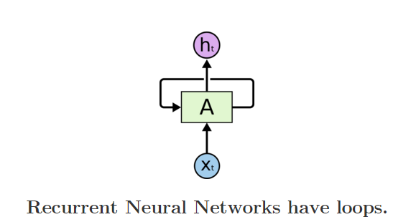
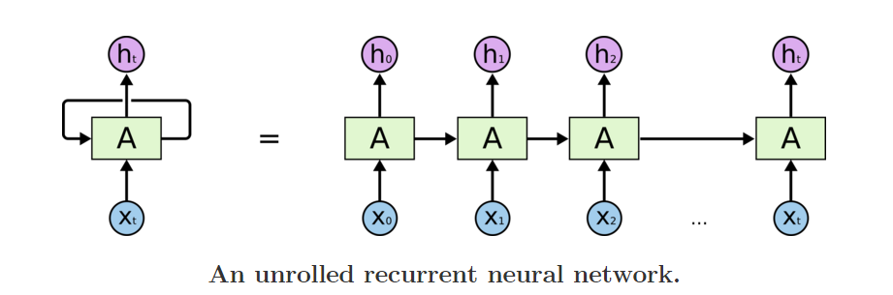
Recurrent Neural Networks
Recurrent Neural Networks are networks with loops in them, allowing information to persist.
In the above diagram, a chunk of neural network, A, looks at some input xt and outputs a value ht.
A loop allows information to be passed from one step of the network to the next.
A recurrent neural network can be thought of as multiple copies of the same network, each passing a message to a successor.
The diagram above shows what happens if we unroll the loop.

Slide 50
Recurrent Neural Networks
Intuition of Recurrent Neural Networks
Human thoughts have persistence; humans don’t start their thinking from scratch every second.
As you read this sentence, you understand each word based on your understanding of previous words.
One of the appeals of RNNs is the idea that they are able to connect previous information to the present task
E.g., using previous video frames to inform the understanding of the present frame.
E.g., a language model tries to predict the next word based on the previous ones.

Slide 51

Recurrent Neural Networks
Examples of Recurrent Neural Networks
Each rectangle is a vector and arrows represent functions (e.g. matrix multiply).
Input vectors are in red, output vectors are in blue and green vectors hold the RNN's state
1
2
3
4
5
(1) Standard mode of processing without RNN, from fixed-sized input to fixed-sized output (e.g. image classification).
(2) Sequence output (e.g. image captioning takes an image and outputs a sentence of words).
(3) Sequence input (e.g. sentiment analysis where a given sentence is classified as expressing positive or negative sentiment).
(4) Sequence input and sequence output (e.g. Machine Translation: an RNN reads a sentence in English and then outputs a sentence in French).
(5) Synced sequence input and output (e.g. video classification where we wish to label each frame of the video).

Slide 52
Recurrent Neural Networks
Incredible success applying RNNs to language modeling and sequence learning problems
Task | Input Sequence | Output Sequence
Machine translation (Sutskever et al. 2014) | English | French
Question answering (Bordes et al. 2014) | Question | Answer
Speech recognition (Graves et al. 2013) | Voice | Text
Handwriting prediction (Graves 2013) | Handwriting | Text
Opinion mining (Irsoy et al. 2014) | Text | Opinion expression

Slide 53
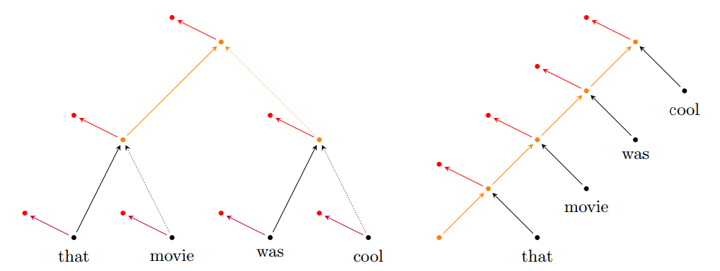
Recursive Neural Networks
A recursive NN can be seen as a generalization of the recurrent NN
A recurrent neural network is in fact a recursive neural network with the structure of a linear chain
Recursive NNs operate on hierarchical structure, Recurrent NN operate on progression of time
Applied to parsing, sentence-level sentiment analysis, and paraphrase detection.
Operation of a recursive net (a), and a recurrent net (b) on an example sentence. Note the linear chain in (b)
Black, orange and red dots represent input, hidden and output layers, respectively.
Directed edges having the same color-style combination denote shared connections.

Slide 54
Recursive Neural Networks
Given the structural representation of a sentence, e.g. a parse tree:
Recursive Neural Networks recursively generate parent representations in a bottom-up fashion,
By combining tokens to produce representations for phrases, eventually producing the whole sentence.
The sentence-level representation (or, alternatively, its phrases) can then be used to make a final classification for a given input sentence — e.g. whether it conveys a positive or a negative sentiment.

Slide 55
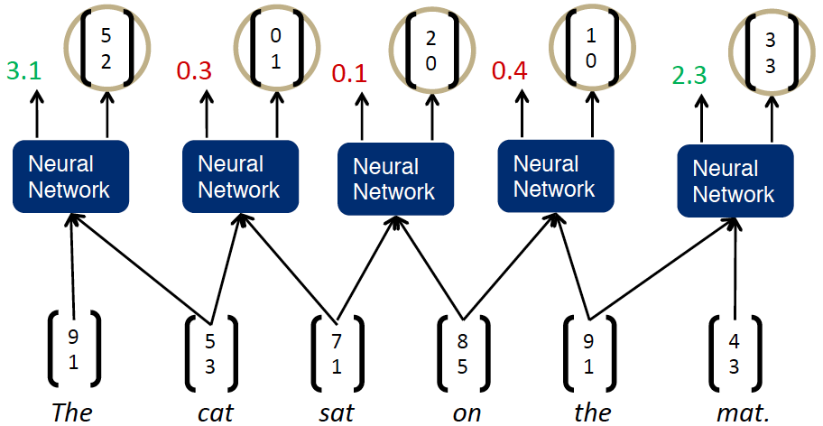
Recursive Neural Network Illustration (Animation)

Slide 56
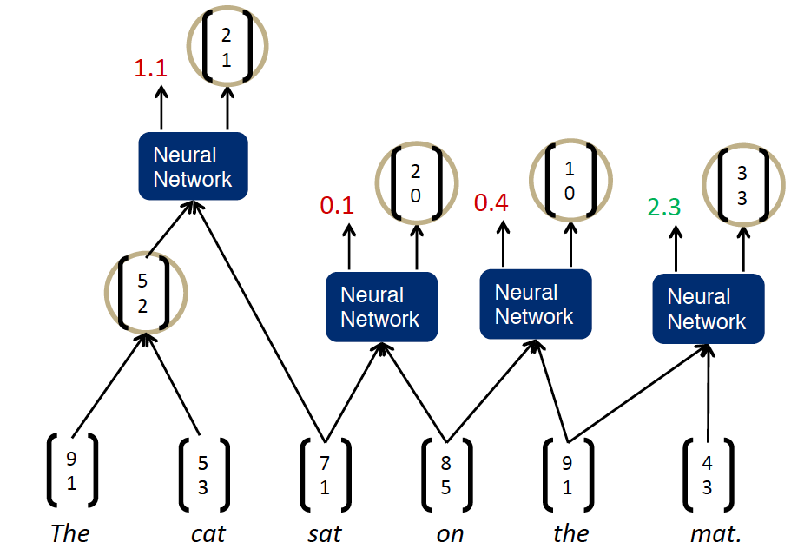
Recursive Neural Network Illustration (Animation)

Slide 57
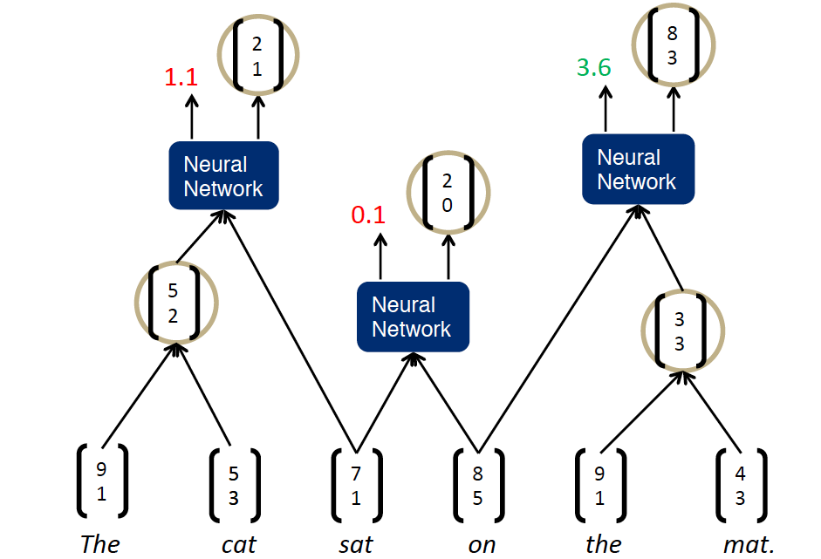
Recursive Neural Network Illustration (Animation)

Slide 58
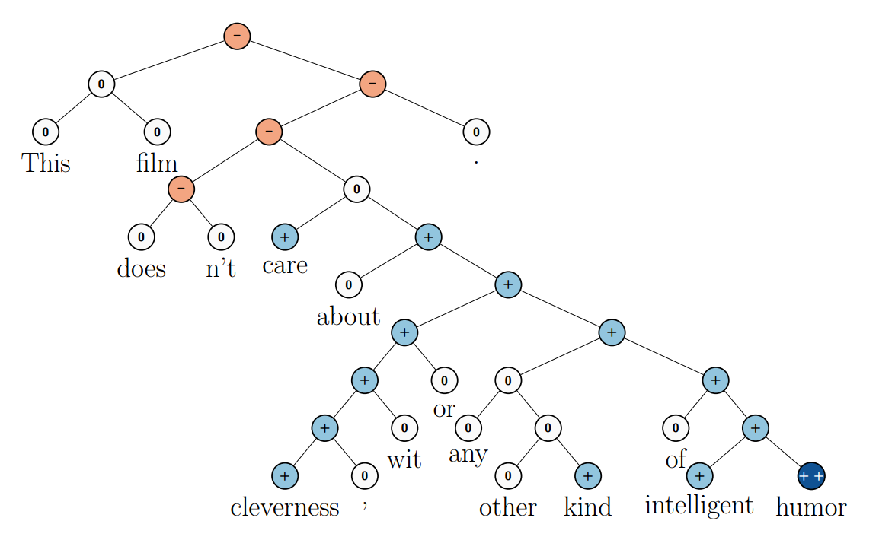
Recursive Neural Networks
Recursive neural networks have had significant successes in a number of NLP tasks.
Socher et al. (2013) uses a recursive neural network to predict sentence sentiment:
Fine-grained sentiment analysis
Allocate positive and negative sentiment from words to phrases and to the entire sentence

Slide 59
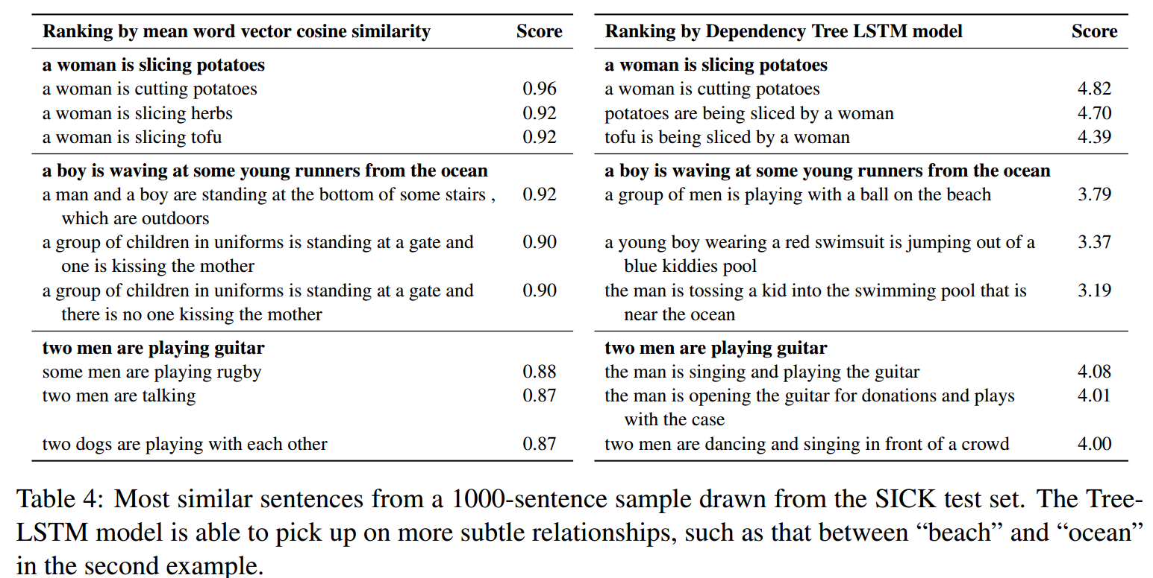
Recursive Neural Networks
SemEval 2014: Predicting semantic relatedness of two sentences (Tai et al. 2015)
Recursive NN based model can pick up more subtle semantic relatedness in sentences compared to word vector model, e.g., ocean and beach.

Slide 60
Vector Representation of Words
Vector space models (VSMs) represent (embed) words in a continuous vector space
Theoretical foundation in Linguistics: Distributional Hypothesis
Words with similar meanings will occur with similar neighbors if enough text material is available (Rubenstein et al. 1967).
Approaches that leverage VSMs can be divided into two categories
Approach | Example | Description
Count-based methods | Latent semantic analysis | Compute how often some word co-occurs with its neighbor words in a large text corpus, and then map these count-statistics down to a small, dense vector for each word
Predictive methods | Neural probabilistic language model | Directly predict a word from its neighbors in terms of learned small, dense embedding vectors (considered parameters of the model)

Slide 61
Word2vec –Vector Representation of Words (Mikolov et al. 2013)
Word2vec: computationally-efficient, 2-layer predictive NN for learning word embeddings from raw text
Considered deep for its ability to digest expansive data sets quickly
Can be used for unsupervised learning of words
Relationships between different words
Ability to abstract higher meaning between words (e.g., Tucson is a city in the state of Arizona)
Useful for language modeling, sentiment analysis, and more
Tucson
Arizona
City
State
Car
Truck
Hand
Glove
Tucson
Arizona

Slide 62
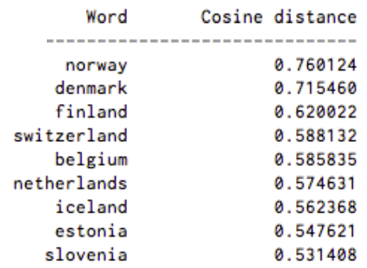
Word2vec –Vector Representation of Words (Mikolov et al. 2013)
Its input is a text corpus and its output is a set of vectors or “embeddings” (feature vectors for words in that corpus)
Similarity between two embeddings represents conceptual similarity of words
Example results: words associated with Sweden, in order of proximity:

Slide 63
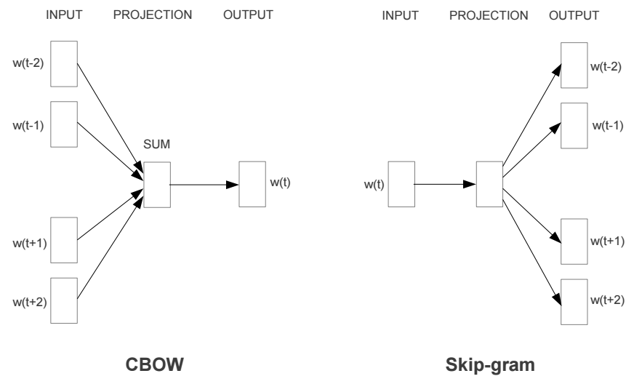
Word2vec –Vector Representation of Words (Mikolov et al. 2013)
Word2vec comes with two models:
Model | Approach | Speed and Performance | Use case
Continuous Bag-of-Words model (CBOW) | The CBOW predicts the current word based on the context. | Faster to train than the skip-gram model | Predicts frequent words better
Skip-Gram model | Skip-gram predicts surrounding words given the current word. | Usually performs better than CBOW | Predicts rare words better
Notes:
Algorithmically, these models are similar, except that CBOW predicts target words (e.g. 'mat') from source context words ('the cat sits on the'), while the skip-gram does the inverse and. This inversion might seem like an arbitrary choice, but statistically it has the effect that CBOW smoothes over a lot of the distributional information (by treating an entire context as one observation). For the most part, this turns out to be a useful thing for smaller datasets. However, skip-gram treats each context-target pair as a new observation, and this tends to do better when we have larger datasets. We will focus on the skip-gram model in the rest of this tutorial.

Slide 64
Word2vec –Vector Representation of Words (Mikolov et al. 2013)
Skip-gram learning:
Given w_{0,} predict w₋₂, w₋₁, w₁, and w₂
Conversely, CBOW tries to predict w₀ when given w₋₂, w₋₁, w₁, and w₂
w₋₂ | w₋₁ | w₀ | w₁ | w₂
? | ? | Network | ? | ?
w₋₂ | w₋₁ | w₀ | w₁ | w₂
Recurrent | Neural |  | Language | Model
Notes:
Algorithmically, these models are similar, except that CBOW predicts target words (e.g. 'mat') from source context words ('the cat sits on the'), while the skip-gram does the inverse and. This inversion might seem like an arbitrary choice, but statistically it has the effect that CBOW smoothes over a lot of the distributional information (by treating an entire context as one observation). For the most part, this turns out to be a useful thing for smaller datasets. However, skip-gram treats each context-target pair as a new observation, and this tends to do better when we have larger datasets. We will focus on the skip-gram model in the rest of this tutorial.

Slide 65
Running Word2Vec
Download: https://code.google.com/archive/p/word2vec/
Word2Vec comes bundled with many files. Two important ones:
Word2vec.c - the actual Word2Vec program written in C; is executed in command line
Demo-word.sh - shell script containing example of how to run Word2Vec.c on test data
To use Word2Vec, you need:
A corpus (e.g., collection of tweets, news articles, product reviews)
Word2Vec expects a sequence of sentences as input
One input file containing many sentences, with one sentence per line
A C programming language compiler
Unix environments are easiest - Linux generally ships with ‘gcc’ pre-installed, OSX can use Xcode
Word2Vec is useful for language modeling tasks,

Slide 66
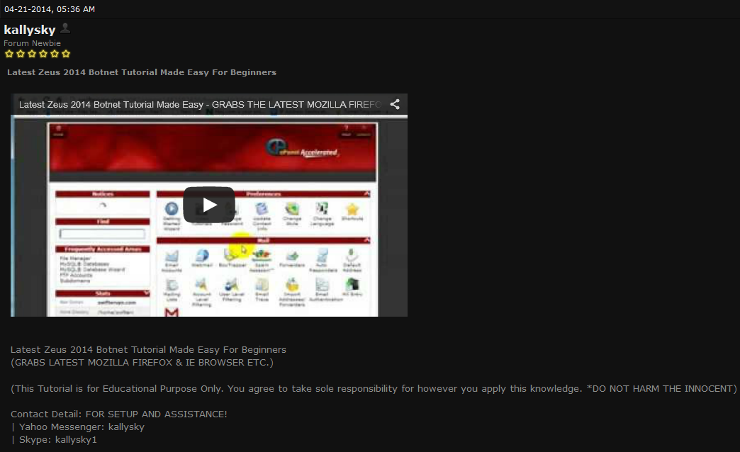
Word2Vec Example
Example: Zeus refers to a botnet and not Greek mythology
Word2Vec can provide automated understanding of unfamiliar terms and language
We further explore this use-case as an illustrative example
Video tutorial for configuring Zeus botnet
Message text: “Latest Zeus 2014 Botnet Tutorial Made Easy For Beginners”

Slide 67
Word2Vec Example
Word2Vec
Benjamin, V., & Chen, H. (2015). Developing understanding of hacker language through the use of lexical semantics. In 2015 IEEE International Conference on Intelligence and Security Informatics (ISI), (pp. 79-84).
Hacker Community Collection
Data
Pre-Processing
Lexical Semantics
Evaluation
Hacker Forum Identification
Text Data Extraction
Vector Representation of Words
Benchmark Experiments
Automated Crawling
Text Normalization
Learning Task and Training Algorithm
Hacker Term Similarity
Identity Obfuscation
Stop Word Removal

Slide 68
Word2Vec Example
We identify and collect two hacker forums:
Text Data Extraction
Extract forum message data from raw webpages
Thread titles, message bodies
Text Normalization
Strip punctuation from words
Remove stop words
Scrubbed data is fed into Word2Vec one sentence at a time
Word2Vec’s input is a single text file
Each row of the input file represents one sentence
Forum | Members | Threads | Posts | Time Span
HackFive | 947 | 1,108 | 5,334 | 1/24/2013 –12/30/2014
HackHound | 633 | 507 | 3,622 | 12/10/2012 –12/30/2014
Hacker Community Collection
Data
Pre-Processing
Hacker Forum Identification
Text Data Extraction
Automated Crawling
Text Normalization
Identity Obfuscation
Stop Word Removal

Slide 69
Word2Vec Example
Many parameters can be altered to change Word2Vec behavior
Architecture: Skip-gram (slower, better for infrequent words) vs CBOW (fast)
Training algorithm: Hierarchical Softmax (better for infrequent words) vs Negative Sampling (better for frequent words, better with low dimensional vectors)
Dimensionality of the word vectors: How many elements per word vector
Context (window) size: Size of sliding window used to iterate through words for training
Skip-gram with negative sampling configuration generally provides best performance (Mikolov et al., 2013)
Additionally, Word2Vec comes default with recommended parameters
Default size for word vector dimensionality is 200 words
Default context window size of 10 words
Lexical Semantics
Learning Task and Training Algorithm
Word Embeddings

Slide 70
Word2Vec Example
Hacker Forum Sentences
Word2Vec
Word Embeddings
Lexical Semantics
The output of Word2Vec is a file called Vectors.bin
Can be opened and viewed in plaintext
Contains embeddings of each word in corpus
Generated embeddings can be used in two ways:
Directly evaluated to better understand underlying corpus
Fed into other models and deep learning algorithms as features
Learning Task and Training Algorithm
Word Embeddings

Slide 71
Word2Vec Example
We directly evaluate word embeddings in this study
Embeddings are vectors, can use cosine similarity to find similar words
Useful in hacker context to discover new hacker terms, tool names, etc.
Evaluation
Benchmark Experiments
 | Most Similar Embeddings for “Botnet”
 | Word | Similarity Score
1 | Citadel | 0.561456
2 | Zeus | 0.554653
3 | Partners | 0.548900
4 | Pandemiya | 0.545221
5 | Mailer | 0.540075
6 | Panel | 0.524557
7 | Linksys | 0.498224
8 | Cythosia | 0.480465
9 | Phase | 0.464738
10 | Spyeye | 0.459695
P@10 | 70%
Hacker Term Similarity

Slide 72
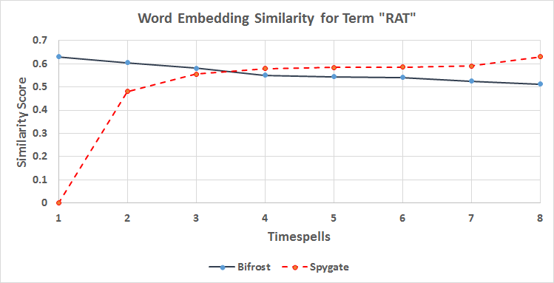
Word2Vec Example
Bifrost and Spygate are remote administration tools (RATs) that grant hackers backdoor access to victim computers
Can look at their similarity with word RAT over time to assess evolving significance in discussions concerning RATS
Evaluation
Benchmark Experiments
Hacker Term Similarity

Slide 73
Recursive Neural Network Example – Identifying Key Carding Sellers
The carding community rely heavily on the online black market for exchanging malwares and stolen data.
Online black market for carders:
Sellers advertise their malwares and/or stolen data by posting a thread in the carding community
Buyers leave feedback commenting the their evaluation of the seller.
Objective: to identify key carding sellers through evaluating buyers feedback.

Slide 74
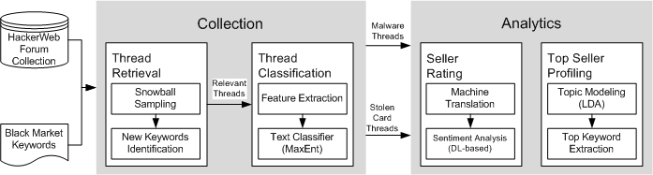
Recursive Neural Network Example – Identifying Key Carding Sellers
Input: Original threads from hacker forums
Preprocessing:
Thread Retrieval: Identifying threads related to the underground economy by conducting snowball sampling-based keywords search
Thread Classification: Identifying advertisement threads using MaxEnt classifier
Focusing on malware advertisements and stolen card advertisement
Can be generalized to other advertisements.
Recursive Neural Network

Slide 75
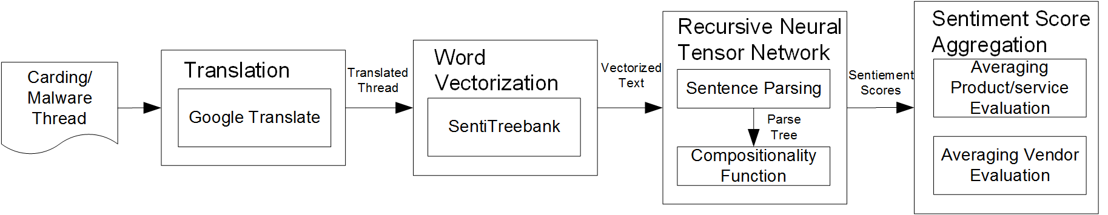
Recursive Neural Network Example – Identifying Key Carding Sellers
Seller Rating
Translation translates the thread content from the original language to English.
Word Vectorization vectorizes each word in the text into a five dimensional vector using SentiTreeBank, a dictionary for customer feedback(Socher et al., 2013).
SentiTreebank: corpus with fully labeled parse trees with sentiment on each level
Recursive Neural Tensor Network parses the sentence into a binary tree and aggregate semantics from constituents recursively.
Sentiment Score Aggregation averages the sentiment measures for each advertisement and seller.

Slide 76
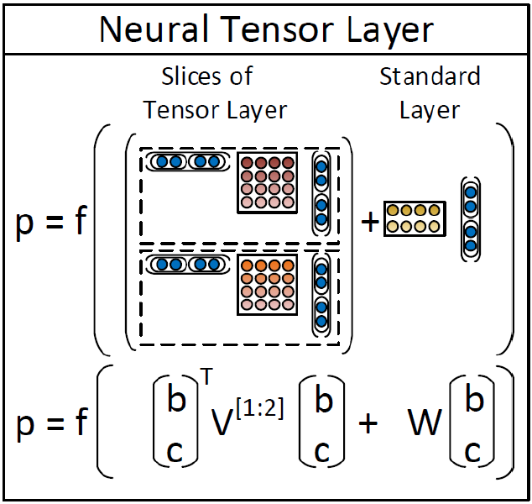
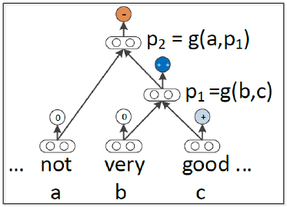

Recursive Neural Network Example – Identifying Key Carding Sellers
Example feedback: “The dump is not very good”
Recursive Neural Tensor Network
Compositionality function
Phrase Output
The additional tensor layer makes the compositional function more powerful by introducing the product of the constituent word embeddings.
compositionality function
Product term
Linear term
Word embeddings trained by SentiTreeBank
Output of the example feedback: Negative

Slide 77
Recursive Neural Network Example – Identifying Key Carding Sellers
Top 3 Best/Worst Malware and Stolen Data Sellers for Each Forum
 | Top 3 Best |  |  |  | Top 3 Worst
 | Malware |  | Stolen Data |  | Malware |  | Stolen Data
Rank | User | Score | User | Score | User | Score | User | Score
 | Antichat
1 | L**G | 5 | i**o | 3.6 | N**g | 1.8 | I**s | 2.3
2 | V**U | 4.5 | a**s | 3.5 | k**a | 2 | P**A | 2.3
3 | g**l | 4 | D**R | 3.4 | D**i | 2 | s**8 | 2.4
 | CrdPro
1 | H**l | 4 | R**r | 4.4 | N**0 | 2 | f**4 | 1.3
2 | b**t | 4 | F**x | 4 | 1**4 | 2 | s**3 | 1.3
3 | S**r | 4 | R**c | 4 | M**D | 2 | l**u | 1.3
 | Zloy
1 | P**t | 5 | B**r | 4 | r**t | 1.5 | r**y | 1
2 | D**n | 4 | B**1 | 4 | w**0 | 1.6 | m**n | 1
3 | D**f | 4 | s**c | 4 | g**n | 2 | j**a | 2

Slide 78
Outline
Introduction
Motivation
Deep Learning Intuition
Neural Network
Neuron, Feedforward algorithm, and Backpropagation algorithm
Limitations
Deep Learning
Deep Belief Network: Autoencoder & Restricted Boltzman Machine
Convolutional Neural Network
Deep Learning for Text Mining
Word Embedding
Recurrent Neural Network
Recursive Neural Network
Conclusions

Slide 79
Conclusion
Deep learning = Learning Hierarchical Representations
Deep learning is thriving in big data analytics, including image processing, speech recognition, and natural language processing.
Deep learning has matured and is very promising as an artificial intelligence method.
Still has room for improvement:
Scaling computation
Optimization
Bypass intractable marginalization
More disentangled abstractions
Reasoning from incrementally added facts

Slide 80
Deep Learning Resources
Name | Language | Link | Note
Pylearn2 | Python | http://deeplearning.net/software/pylearn2/ | A machine learning library built on Theano
Theano | Python | http://deeplearning.net/software/theano/ | A python deep learning library
Caffe | C++ | http://caffe.berkeleyvision.org/ | A deep learning framework by Berkeley
Torch | Lua | http://torch.ch/ | An open source machine learning framework
Overfeat | Lua | http://cilvr.nyu.edu/doku.php?id=code:start | A convolutional network image processor
Deeplearning4j | Java | http://deeplearning4j.org/ | A commercial grade deep learning library
Word2vec | C | https://code.google.com/p/word2vec/ | Word embedding framework
GloVe | C | http://nlp.stanford.edu/projects/glove/ | Word embedding framework
Doc2vec | C | https://radimrehurek.com/gensim/models/doc2vec.html | Language model for paragraphs and documents
StanfordNLP | Java | http://nlp.stanford.edu/ | A deep learning-based NLP package
TensorFlow | Python | http://www.tensorflow.org | A deep learning based python library

Slide 81
References
Bordes, A., Chopra, S., & Weston, J. (2014). Question answering with subgraph embeddings. arXiv preprint arXiv:1406.3676.
Graves, A., Mohamed, A. R., & Hinton, G. (2013, May). Speech recognition with deep recurrent neural networks. In Acoustics, Speech and Signal Processing (ICASSP), 2013 IEEE International Conference on (pp. 6645-6649). IEEE.
Graves, A. (2013). Generating sequences with recurrent neural networks.arXiv preprint arXiv:1308.0850.
Irsoy, O., & Cardie, C. (2014, October). Opinion Mining with Deep Recurrent Neural Networks. In EMNLP (pp. 720-728).
Mikolov, T., Chen, K., Corrado, G., & Dean, J. (2013). Efficient estimation of word representations in vector space. arXiv preprint arXiv:1301.3781.
Rubenstein, H., & Goodenough, J. B. (1965). Contextual correlates of synonymy. Communications of the ACM, 8(10), 627-633.
Socher, R., Perelygin, A., Wu, J. Y., Chuang, J., Manning, C. D., Ng, A. Y., & Potts, C. (2013, October). Recursive deep models for semantic compositionality over a sentiment treebank. In Proceedings of the conference on empirical methods in natural language processing (EMNLP)(Vol. 1631, p. 1642).
Sutskever, I., Vinyals, O., & Le, Q. V. (2014). Sequence to sequence learning with neural networks. In Advances in neural information processing systems (pp. 3104-3112).
Tai, K. S., Socher, R., & Manning, C. D. (2015). Improved semantic representations from tree-structured long short-term memory networks. arXiv preprint arXiv:1503.00075.

